Slide 1

Power BI
Case Study

Slide 2
Problem Statement : HCC Consultant has been hired to present a BI framework to a Super Store Organization. The Super Store organization is interested in using business intelligence solutions to help with strategic decision making and has asked to demonstrate how Business Intelligence tools can analyze their data from a public dataset.
Solution : Analyze Large dataset to provide key insights by creating Power BI Dashboard/Report and develop data driven processes to find Outliers, Trends and Patterns.
Few Initial Problem Solved :
There has been seen a constant decline in sales then a sudden spike and later again a sudden drop.
Outlier found the in Sales Analysis
Discovered some key insights in the package processing time

Slide 3
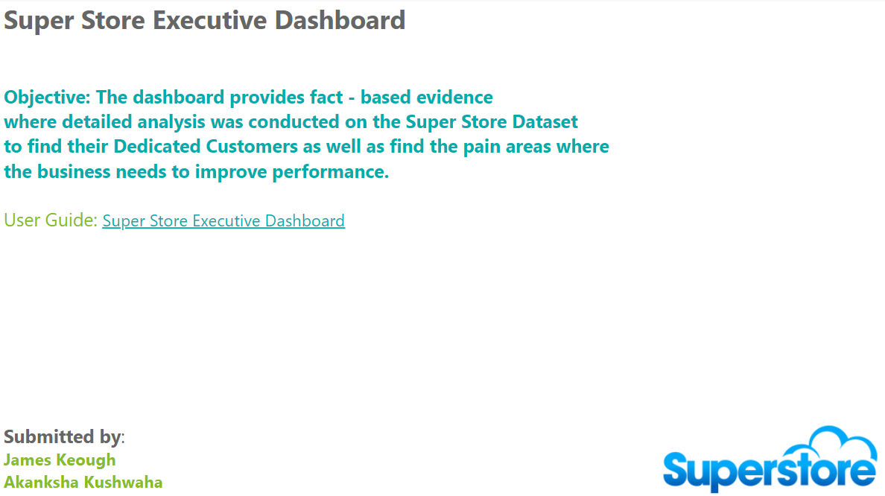
Introduction

Slide 4
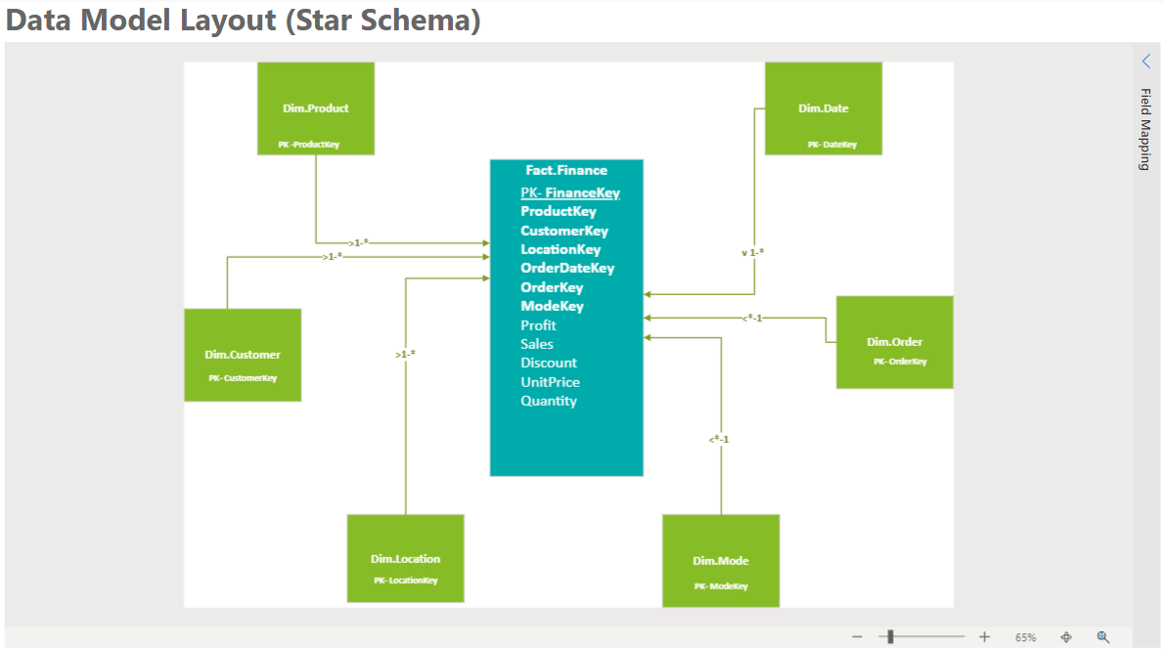
Data Model Blueprint
In this for the relational database warehousing we are going to use the Star Scheme layout.
The Star schemas is named star schema because of its resemblance to a star. With a central Fact table called as the Transactional table. This table mainly has the transactional data like Profit, Sales, Cost, Quantity, Keys etc.
The fact table's primary key is typically a foreign keys in each of the dimension tables, and it uniquely identifies each row of data in the fact table.
Surrounding the Fact table are all Dimension tables. Dimensional tables are defined as the business entities containing attributes. E.g., Product, Employee, Location, Customer etc.

Slide 5
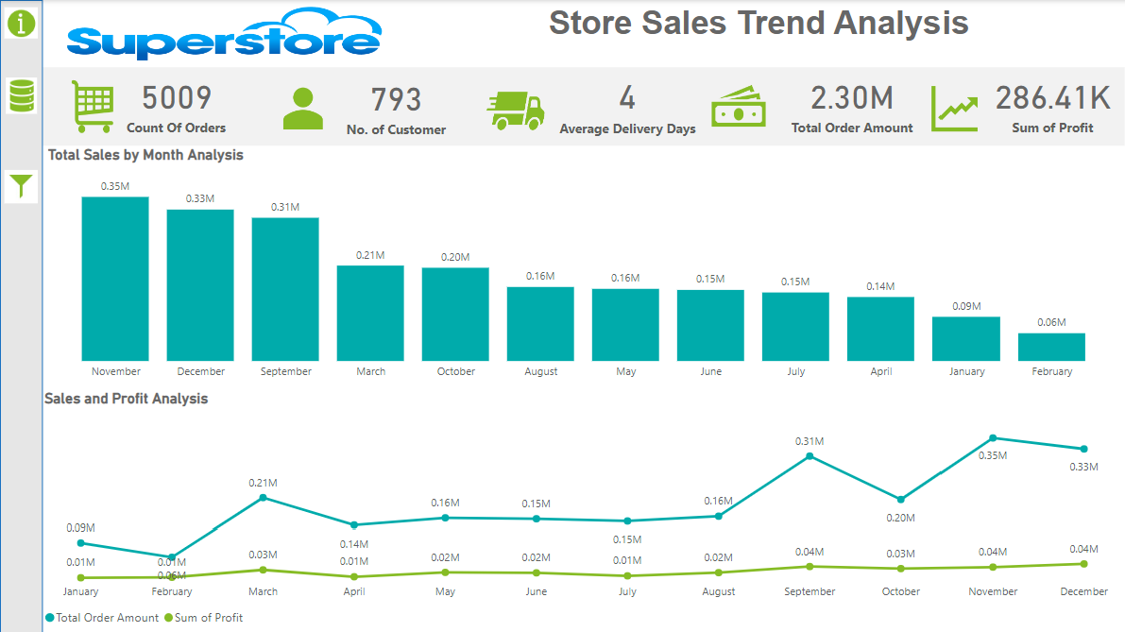
Sales Trend Analysis
The top panel displays crucial KPIs such as Count of Orders, No. of Customer, Average Delivery Days, Total Order Amount and Sum of Profit.
At the left-hand Corner, we have the page navigation buttons like Information, Data Model blueprint and Slicer Panel Button.
In Top Visual we have a Clustered Column Chart that shows Month on X- axis and Total Sales on Y- axis.
The Bottom visual is a Line Chart displaying the trend of Sales & profit amount by fiscal period/Month.
The user can filter by Year, Month, State, Region from the Slicer panel on the left side of the dashboard.

Slide 6
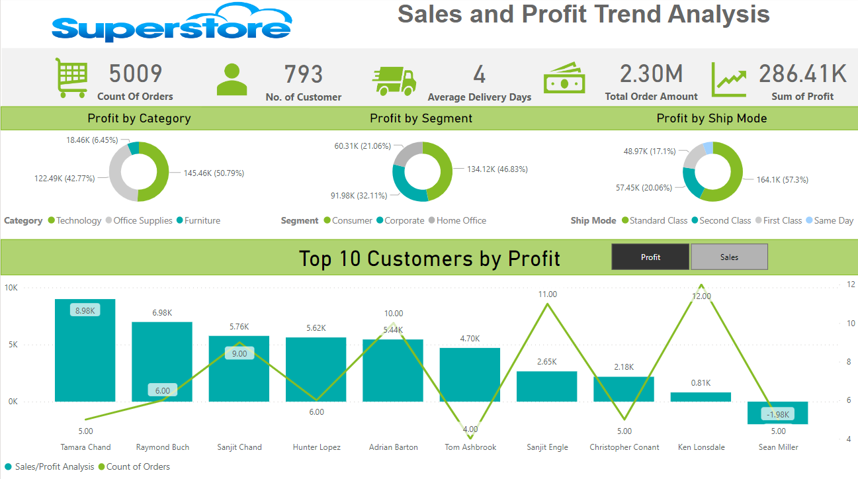
Sales and Profit Trend Analysis by top 10 Customer
The top panel displays dynamic KPIs which changes as per the user selection namely Count of Orders, No. of Customer, Average Delivery Days, Total Order Amount and Sum of Profit.
The top 3 Pie Chart shows the Sales and Profit by Category, Segment and Ship Mode.
The Bottom visual is a Line and Clustered Column Chart that shows the Top 10 Customers By Sales and Profit. The trend line in this visual represents the No. of Orders.
On this page the user can toggle between Sales and Profit. And can slice the enter page based on just Sales or Profit by Clicking the toggle button above the green strip.

Slide 7
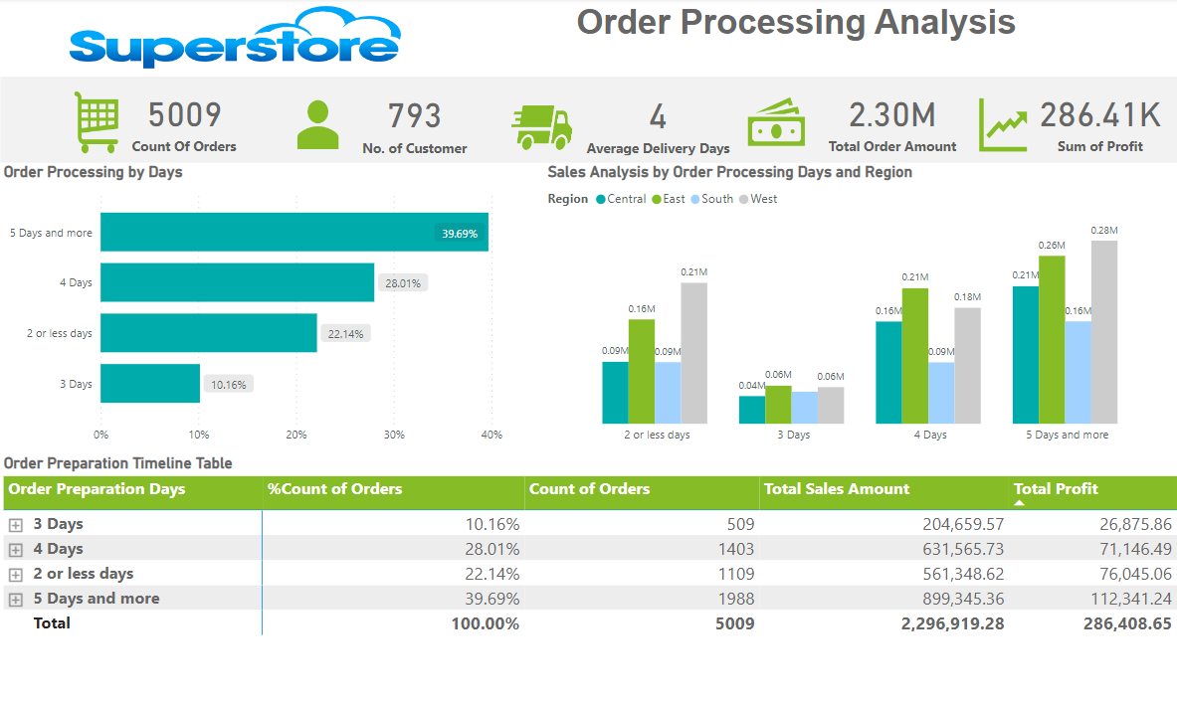
Order Processing Analysis by Order and Ship Date
The Top Left visual is Clustered Bar chart that displays the Order Processing By Days.
The Top Right Visual is a Clustered Column Chart that shows Sales Analysis By Order Processing Days and Region
The Bottom is a Matrix called Order Preparation Timeline Matrix that shows the Order Preparation Days, % of Count of Orders, Count of Orders, Total Sales Amount and Total Profit.
Once the user clicks on the toggle button the Order Preparation Days, they can drill through for more detailed information based on Ship Mode and Geography.

Slide 8

Power BI
Dashboard Demo

Slide 9

Questions

Slide 10
Thank You

